Slide 1

PX505
eTex: Electrical signal conversion of a triboelectric fabrics into a sound or light signal
Azmi Abbessi | Sébastien Barbero | Félix Roux
10/01/2023
Notes:
Sébastien

Slide 2

Plan
Introduction
Demonstrator architecture
Validation environment and results
Societal challenges of their innovation
Demonstration
Notes:
Sébastien

Slide 3
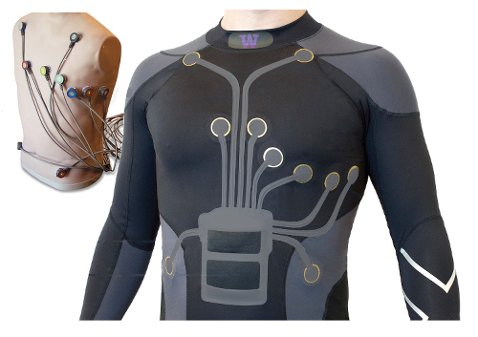

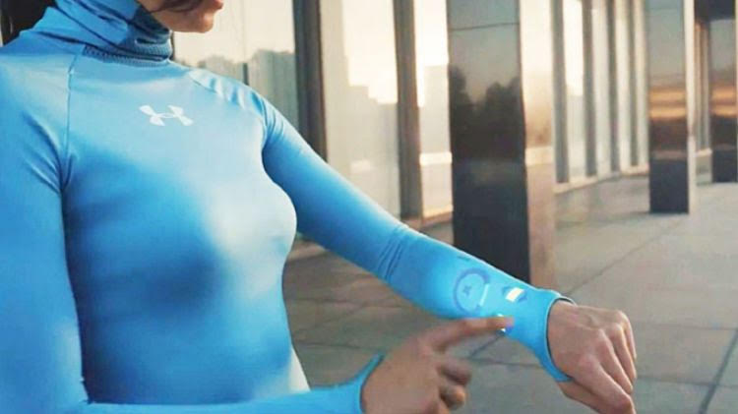
Introduction
https://www.textileblog.com/application-of-smart-textiles-in-medical-and-healthcare/
http://www.gammao.fr/
https://ignasisayol.com/wp-content/uploads/2020/11/Smart-Fabrics.jpg
Notes:
Sébastien

Slide 4
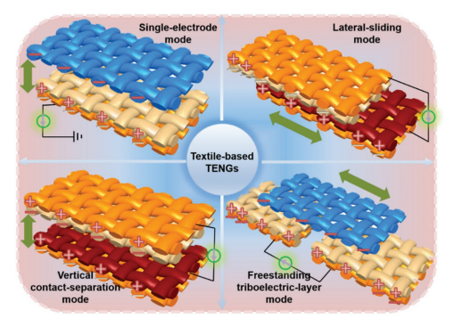
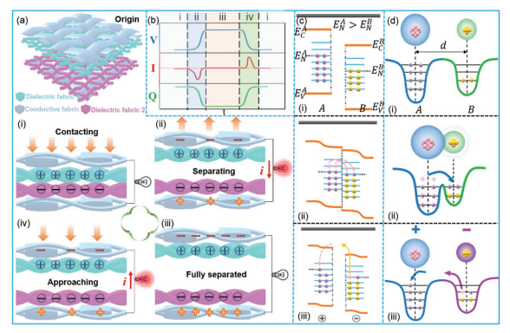
Related work
TriboElectric Nano-Generators
yellow = conductive fabrics
Pictures from :
Fiber/Fabric-Based Piezoelectric and Triboelectric
Nanogenerators for Flexible/Stretchable and Wearable
Electronics and Artificial Intelligence
Kai Dong, Xiao Peng, and Zhong Lin Wang
Notes:
Sébastien

Slide 5


What is MIDI (quickly…)
Communication protocol designed for performative arts
Initially intended to allow hardware synthesisers to work as a complete network
Could be simply described as “sheet music for computers
Is pretty old (25 years !), and still largely in use
Simple MIDI Recording
Sheet music example
Notes:
Félix

Slide 6
Demonstrator architecture
Notes:
Félix

Slide 7
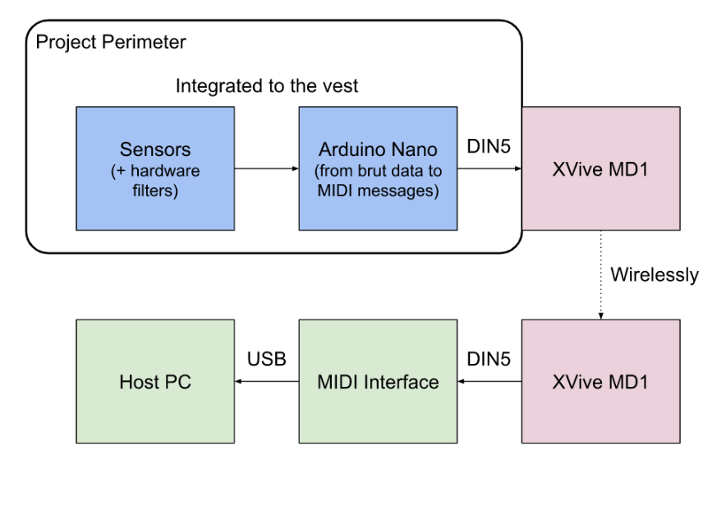
Demonstrator architecture
Notes:
Félix

Slide 8
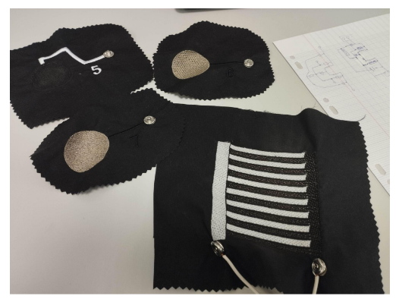
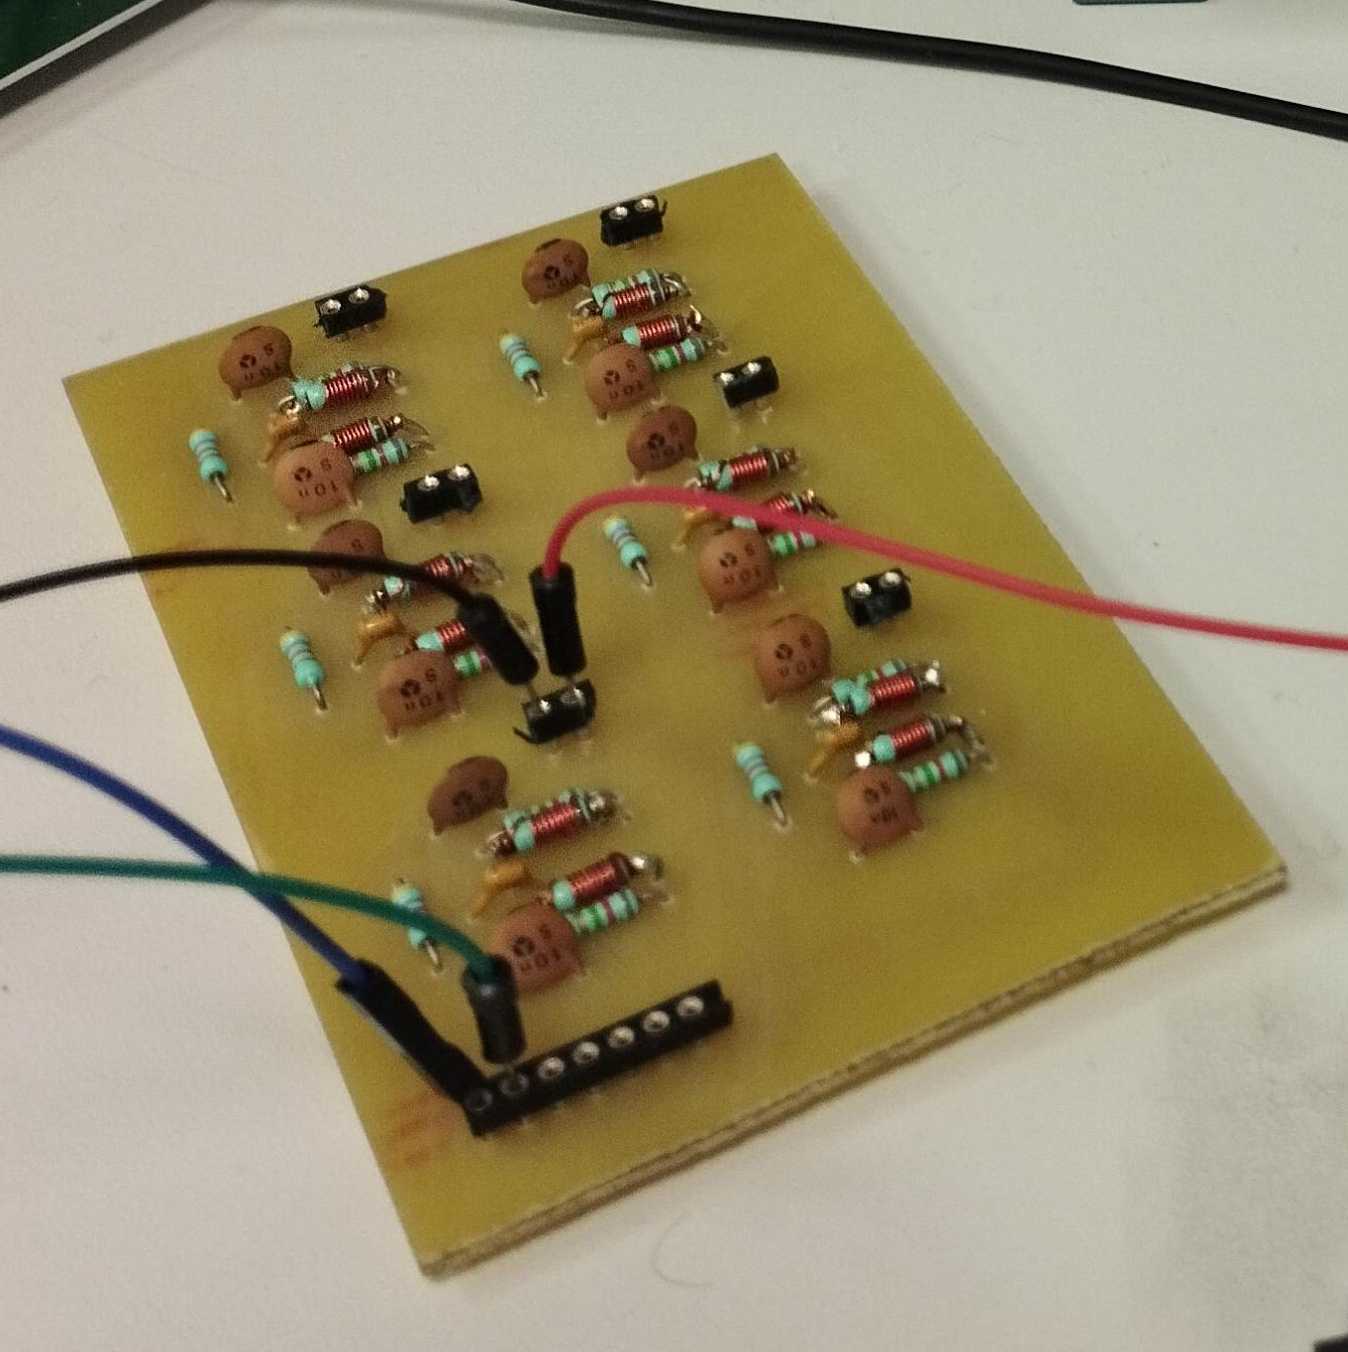
Analog and ADC
Triboelectric Sensors
50 Hz Notch Filters
Notes:
Félix

Slide 9
Embedded Algorithmic
Inactive state
Active state
No
No
Yes
Threshold
Timer up ?
Yes
- MIDI Note On
- Start timer
MIDI Aftertouch
MIDI Note Off
Notes:
Félix

Slide 10

COMMUNICATION
Application case : worn by a dancer
Reliability,Latency and compatibility.
Solution: wirelessly transmit MIDI messages with Bluetooth
Bluetooth connection : really effective and very low-latency
Notes:
azmi

Slide 11
Validation environment and results
Notes:
Azmi

Slide 12
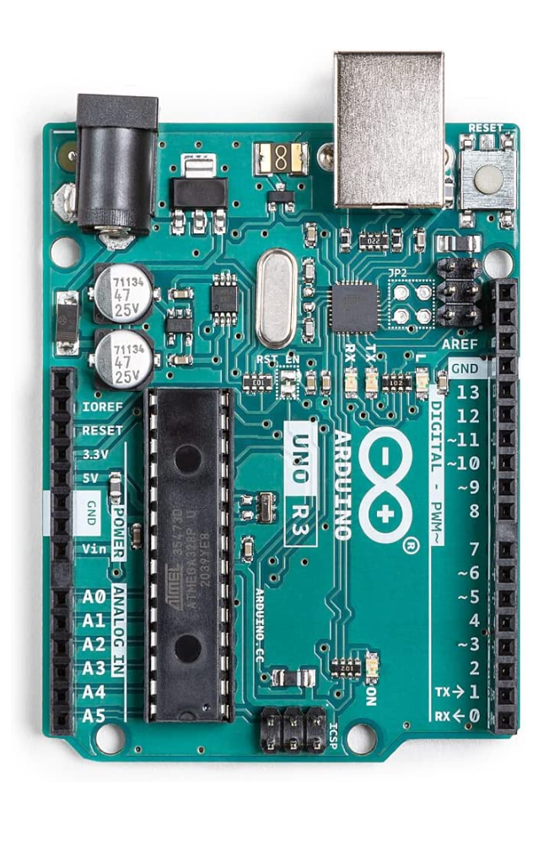

CHOOSING THE TARGET BOARD
Arduino
Because :
easy to program
cheap board
reduced size
Notes:
Sébastien

Slide 13
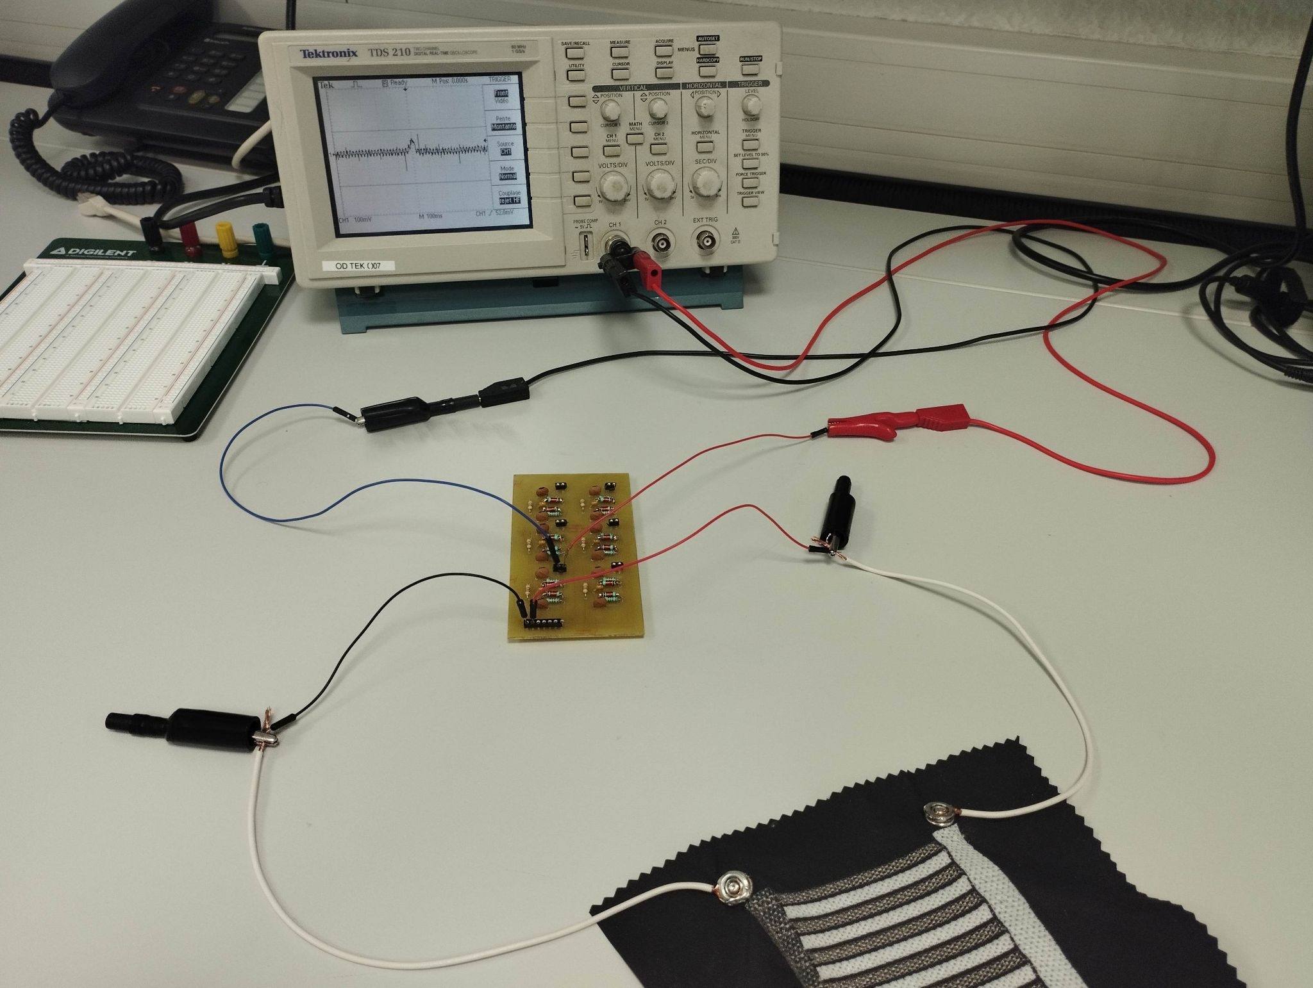
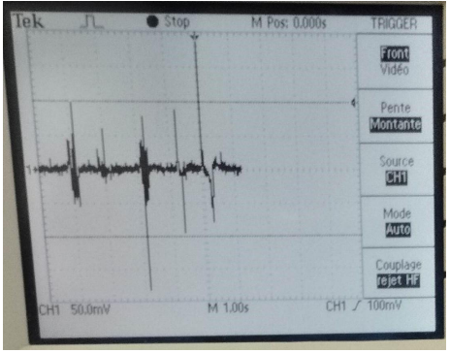
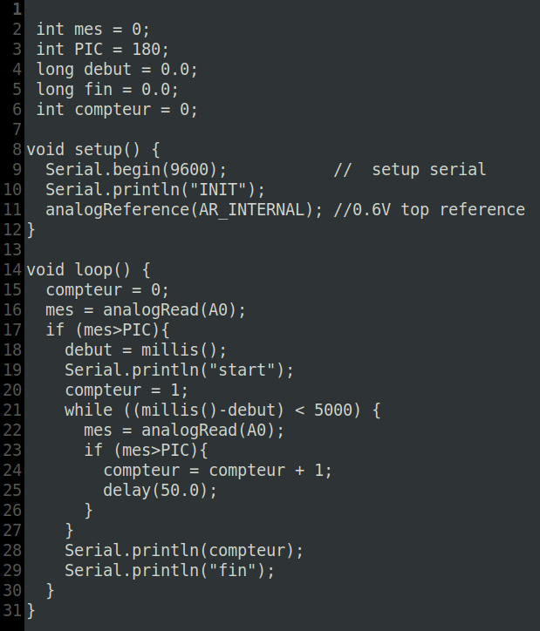
SENSOR CHARACTERIZATION
Setup for testing each sensor
Signals captured with oscilloscope
Threshold detection
Variations due to environment
Notes:
Sébastien

Slide 14
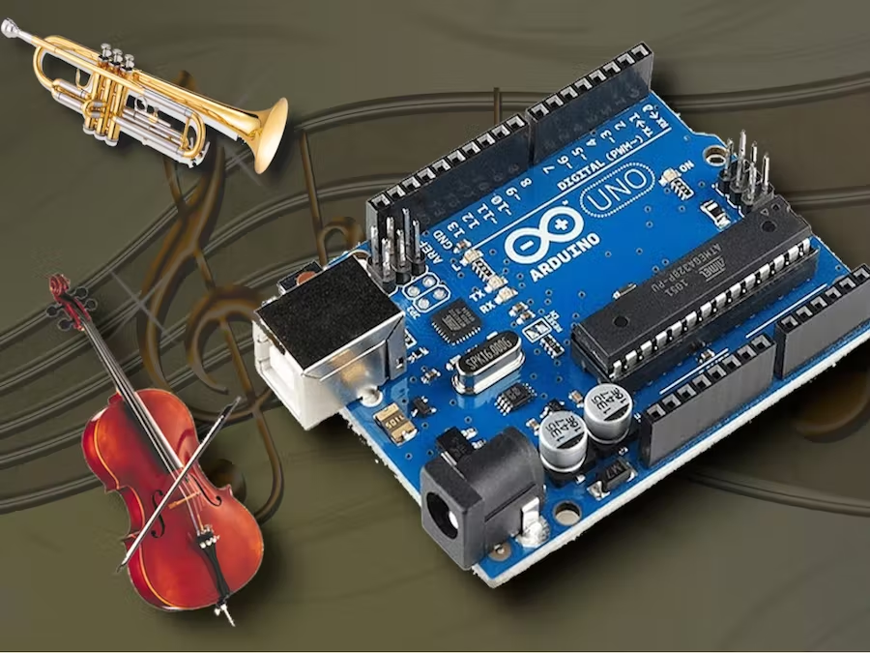
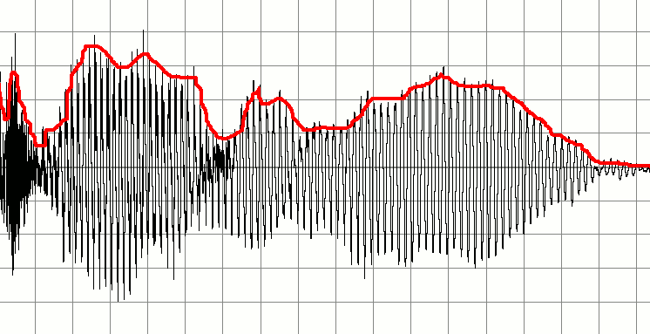
SIGNAL DETECTION ON ARDUINO
Acquisition using the board’s ADCs
Huge latency constraint
Using thresholds as a basic trigger is fine, but requires fine tuning
In the end, an adaptive trigger or another mean of triggering would be more accurate
On-board filtering for the aftertouch events (low-pass, (notch))
Envelope follower for an asynchronous signal
The “cheapest method” has been selected
No need for an expensive method
Notes:
Félix

Slide 15

MIDI CONVERSION
Done via the built-in MIDI Arduino library
Using special messages to carry alteration messages
Non-locking and state-driven code
Simply portable to all numbers of sensors
Memory and processing efficient
Fully customizable
Leaves a range of interpretation possibilities to the user
MIDI protocol implies a possibility of receiving MIDI messages (for future upgrades)
Notes:
Félix

Slide 16
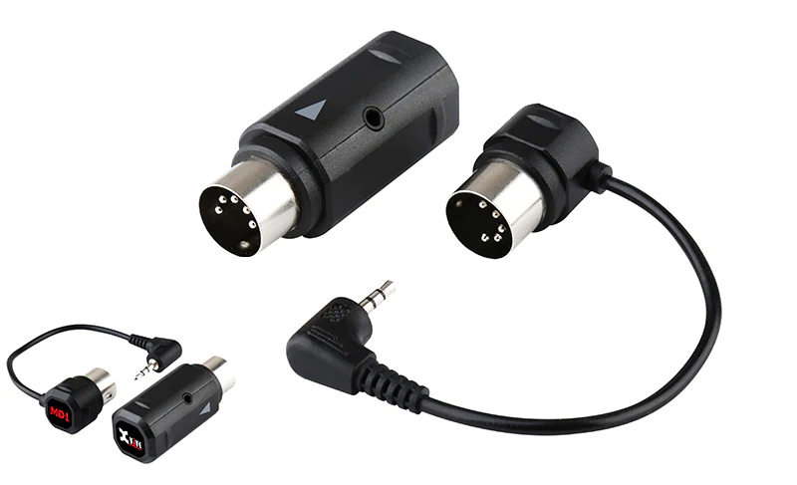
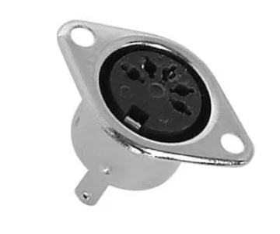
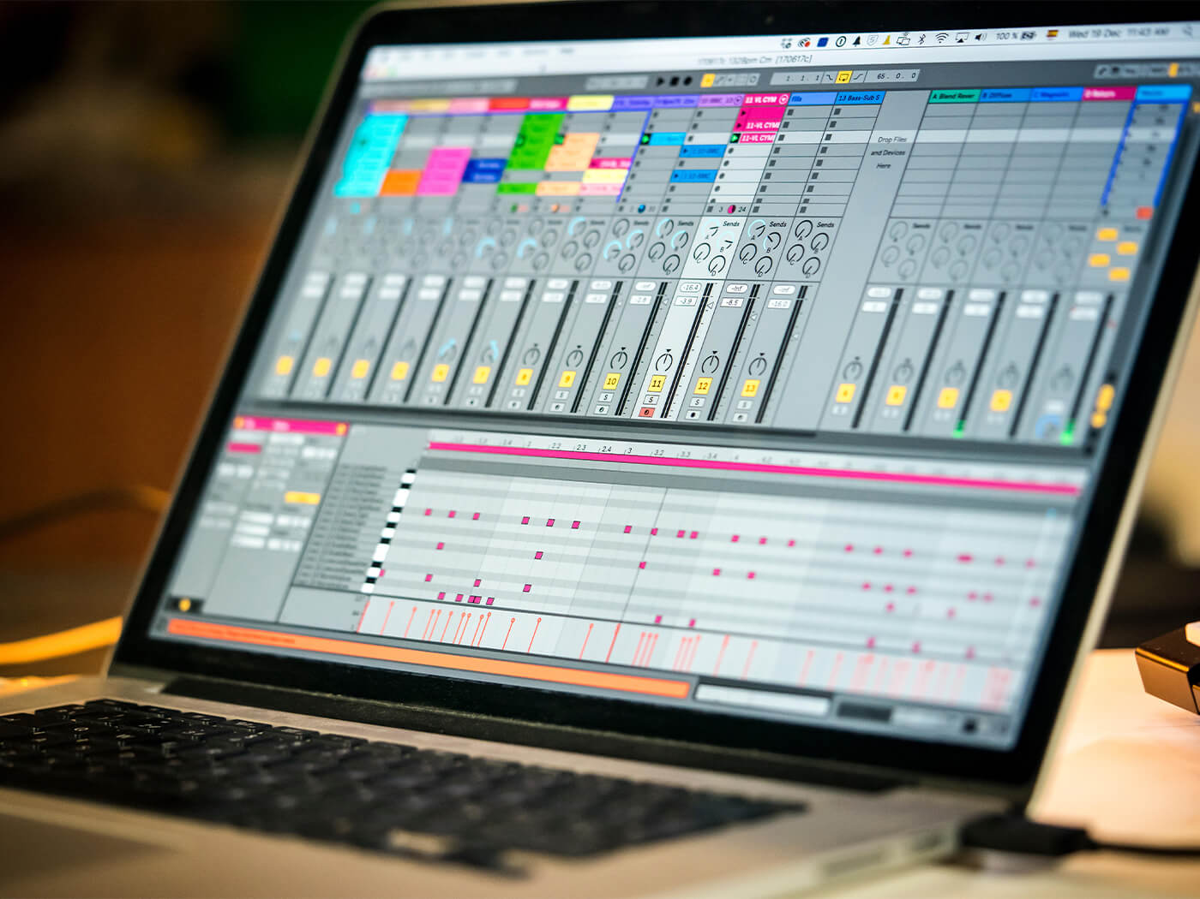
WIRELESS CONNECTION
Xvive MD1 is a wireless MIDI device that transmits MIDI messages wirelessly between devices.
It has a 2.4GHz wireless connection with a range of up to 30 meters.
It is easy to use and eliminates the need for physical cables.
It can be connected to an Arduino using a DIN5 connector.
A MIDI software on a PC can be used to receive MIDI messages from the Arduino.
The MIDI message is displayed in Ableton Live in real time.
Notes:
Azmi

Slide 17
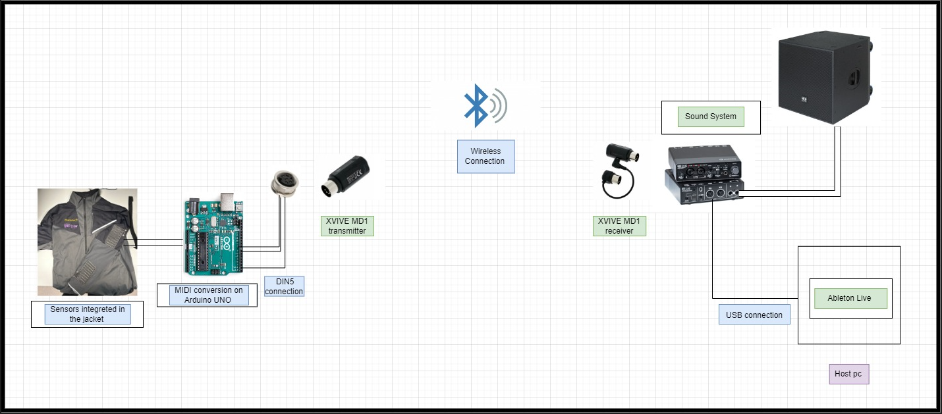
Global architecture for the project
Notes:
Azmi

Slide 18
Societal challenges of their innovation
Notes:
Azmi

Slide 19

Societal challenges of their innovation
Ambient sound, light, and other effects can be changed by artists through triboelectricity.
Triboelectricity is also useful for something called energy harvesting, which means using energy from the environment to power things.
.
The use of energy production methods with negative environmental impacts may be reduced through the implementation of this project, leading to a positive environmental impact.
Solutions using triboelectricity are safe for people to use, and they may even lead to new sources of renewable energy.
.
it's important to think about how we can make electronic clothing with triboelectricity easy to fix, reuse, and dispose of when it's no longer needed.
Notes:
azmi

Slide 20
Demonstration
Notes:
Sébastien

Slide 21
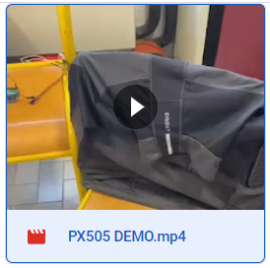
Demonstration
Notes:
Sébastien

Slide 22
Thank you for your attention
Any questions ?
Notes:
Sébastien

